Slide 1
Data Visualization
Data visualization is the study of the visual representation of data.
Presentation of data in a pictorial or graphical format.
Data in spreadsheets is hard to visualize.
It helps to see analytical results presented visually, find relevance among the millions of variables, communicate concepts and hypotheses to others, and even predict the future.
Data visualization makes interpretation easier.

Slide 2
R graphics
R is a powerful environment for data visualization
Integrated graphics
Good quality of graphics
Full control over graphics
Can be reproduced
Huge number of R packages for graphics are available
R graphs can be viewed on screen
R graphs can be saved in various formats like
metafile/pdf/png/jpeg/wmf/tiff/ps etc.

Slide 3
R plotting functions
plot - x-y plotting
barplot - bar plots
boxplot - box & whisker plot
hist - histogram
pie - pie charts
dotchart - dot plots
image, heatmap, contour, persp - functions to generate image like plots
qqnorm, qqline, qqplot - distribution comparison plots
pairs, coplot - display of multivariate data
density - Density plot

Slide 4
Plot function
Bivariate data plot(x,y)
Adding to plots
points(x,y,…) # adds points
abline(a,b,…) # adds line y=a+bx
abline(h=y) # adds a horizontal line
abline(v=x) # adds a vertical line
segments(x1,y1,x2,y2) # draws line segment
arrows(x1,y1, x2,y2) # draws arrow
legend(x,y, legend…), # draws a legend
title(main, sub, xlab, ylab, …) # adds a main title, subtitle,
x-axis label and y-axis label
mtext(text, side, line,…) # draws text in the margin
box(…) # adds a box around the plot region

Slide 5
ggplot 2-grammar of graphics
High-level graphics system
Implements grammar of graphics from Leland Wilkinson
Streamlines many graphics workows for complex plots
Syntax centered around main ggplot function
Simpler qplot function provides many shortcuts
ggplot function accepts two arguments
    Data set to be plotted
    Aesthetic mappings provided by aes function

Slide 6
ggplot- Syntax
Noun ----Data
ggplot(data = df)
Verb :“geom_” + Plot Type
ggplot(data = df) + geom_bar()
Adjectives: Aesthetics (“aes”) (x, y, fill, colour, linetype)
ggplot(data = df,aes(x=categorical.var, fill=group.var)) + geom_bar()
Adverb : stat (e.g. identity, bin)
ggplot(data = df, aes(x=categorical.var, fill=group.var))
+ geom_bar(stat = "bin")
Preposition : position (e.g. fill, dodge, identity)
ggplot(data = df, aes(x=categorical.var, fill=group.var)) +
geom_bar(stat="bin", position = "identity", binwidth=5)

Slide 7
Example
> library(ggplot2)
> data (diamonds)
> ggplot(diamonds,aes(x=carat,y=price,color=cut))+geom_point()
#################################
> data(diamonds)
> dsmall <- diamonds[sample(nrow(diamonds), 1000), ]
> p <- ggplot(dsmall, aes(carat, price, color=color))
> p + geom_point(size=4)
> print(p)
#######################
g <- ggplot(diamonds, aes(x = carat, y = price))
g + geom_point(aes(color = color))
g + geom_point(aes(color = color)) + facet_wrap(~color)
g + geom_point(aes(color = color)) + facet_grid(cut ~ clarity

Slide 8
Data Visualization
The popular saying “a picture is worth a thousand words” refers to the ability to condense diffused verbal information into a compact and quickly understood graphical image. In the case of numbers, data visualization and numerical summarization provide us with both a powerful tool to explore data and an effective way to present results.
Commonly used graphs
Bar graph
Pie chart
Histogram
Boxplot
Line graph
Scatter plot
Advanced Visualization
Heat Map
Mosaic Map
Map visualization
3d Graphs
Correlogram

Slide 9
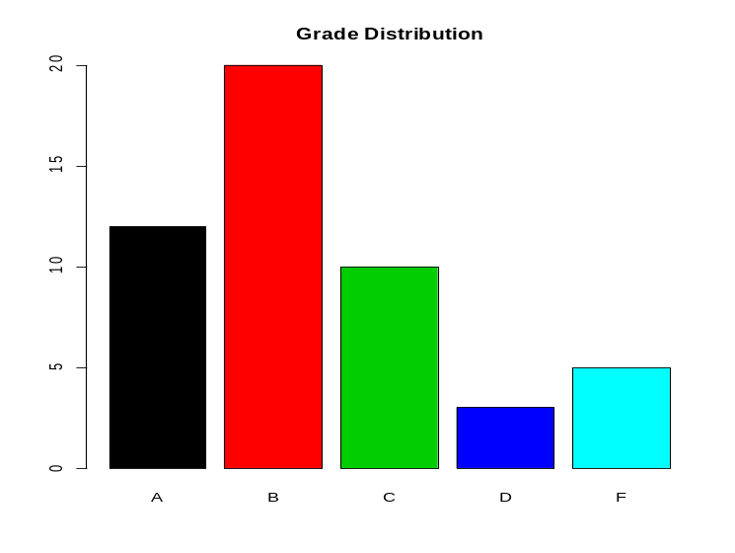
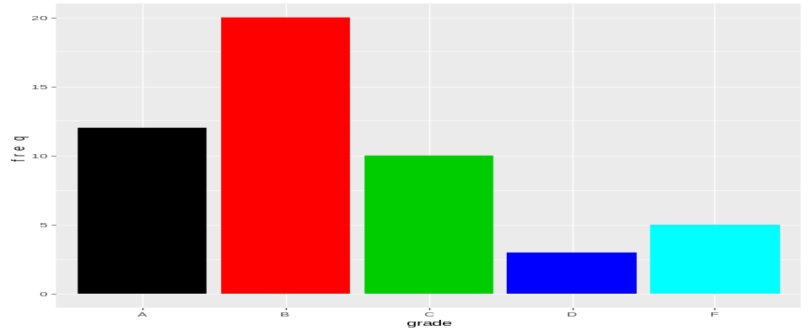
Data Visualization-Bar Graph
grade<-c(12,20,10,3,5)
names(grade)=c("A", "B", "C", "D", "F")
barplot(grade,col=c("1","2","3","4","5"), main="Grade Distribution")
grade<-c(12,20,10,3,5)
names(grade)=c("A", "B", "C", "D", "F")
> library(ggplot2)
> bardata=data.frame(grade=c("A", "B", "C", "D", "F"), freq=c(12,20,10,3,5))
> attach(bardata)
> ggplot(data=bardata, aes(x=grade,y=freq))+geom_bar(stat="identity”, width=0.5)
> ggplot(data=bardata, aes(x=grade,y=freq))+geom_bar(stat="identity", fill=c(1,2,3,4,5))

Slide 10
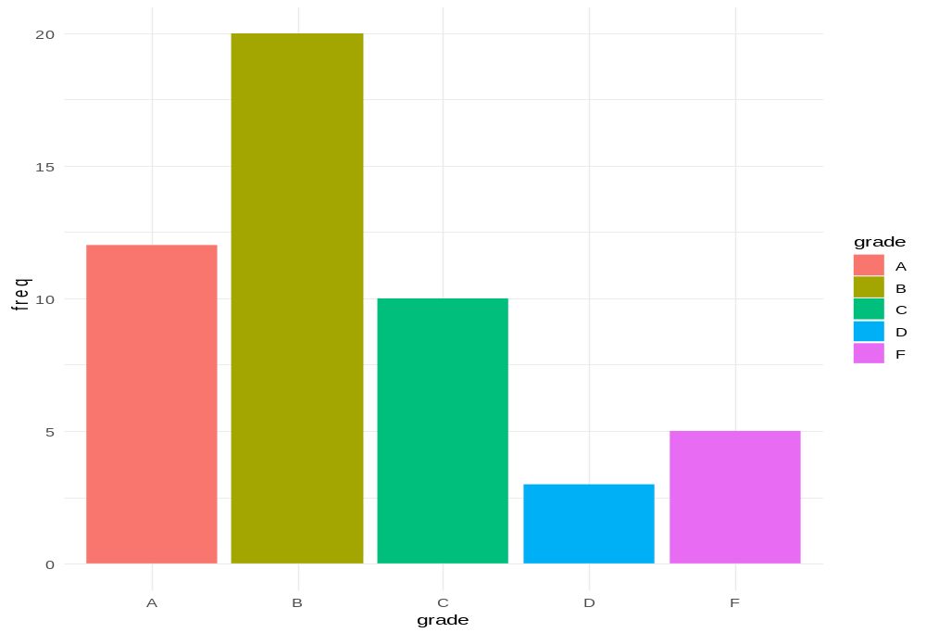
Data Visualization- Bar Graph
> library(ggplot2)
> bardata=data.frame(grade=c("A", "B", "C", "D", "F"), freq=c(12,20,10,3,5))
> attach(bardata)
> ggplot(data=bardata, aes(x=grade,y=freq, fill=grade)) + geom_bar(stat="identity")+theme_minimal()

Slide 11
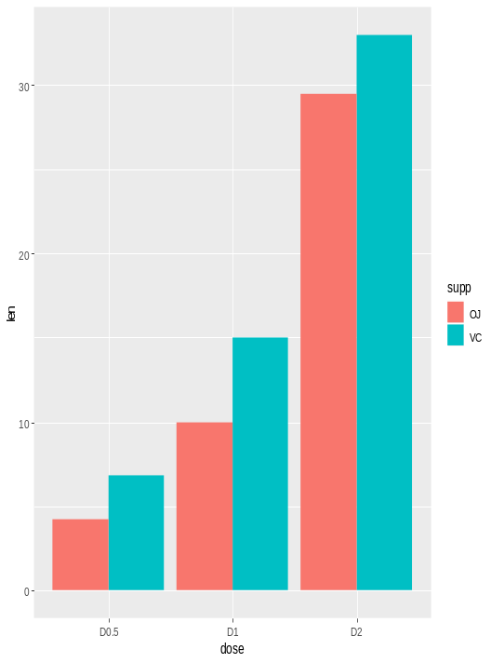
Bar Graph with Multiple Groups
Data derived from ToothGrowth data sets are used. ToothGrowth describes the effect of Vitamin C on tooth growth in Guinea pigs. Three dose levels of Vitamin C (0.5, 1, and 2 mg) with each of two delivery methods [orange juice (OJ) or ascorbic acid (VC)] are used :
library(ggplot2)
df <- data.frame(supp=rep(c("VC", "OJ"), each=3),
dose=rep(c("D0.5", "D1", "D2"),2),
len=c(6.8, 15, 33, 4.2, 10, 29.5))
head(df)
ggplot(data=df, aes(x=dose, y=len, fill=supp)) +
geom_bar(stat="identity")
# Use position=position_dodge()
ggplot(data=df, aes(x=dose, y=len, fill=supp)) +
geom_bar(stat="identity", position=position_dodge())

Slide 12
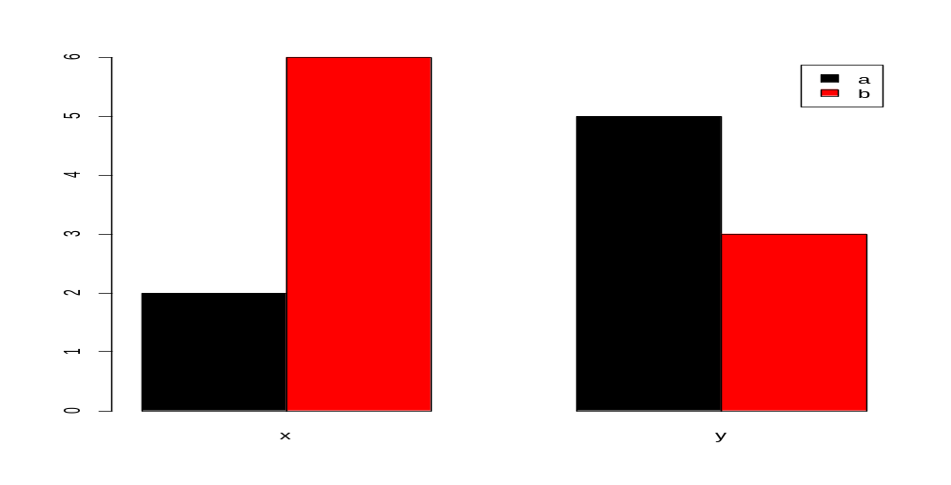
Multiple Bar Graph
x<-c("a","a","b","b","b","b","b","b")
y<-c("a","a" ,"a" ,"a" ,"a","b","b","b")
cc<-cbind(table(x),table(y))
colnames(cc)<-c("x","y")
barplot(cc) # stacked plot
barplot(cc,beside=TRUE,col=c(1,2),legend=rownames(cc))

Slide 13
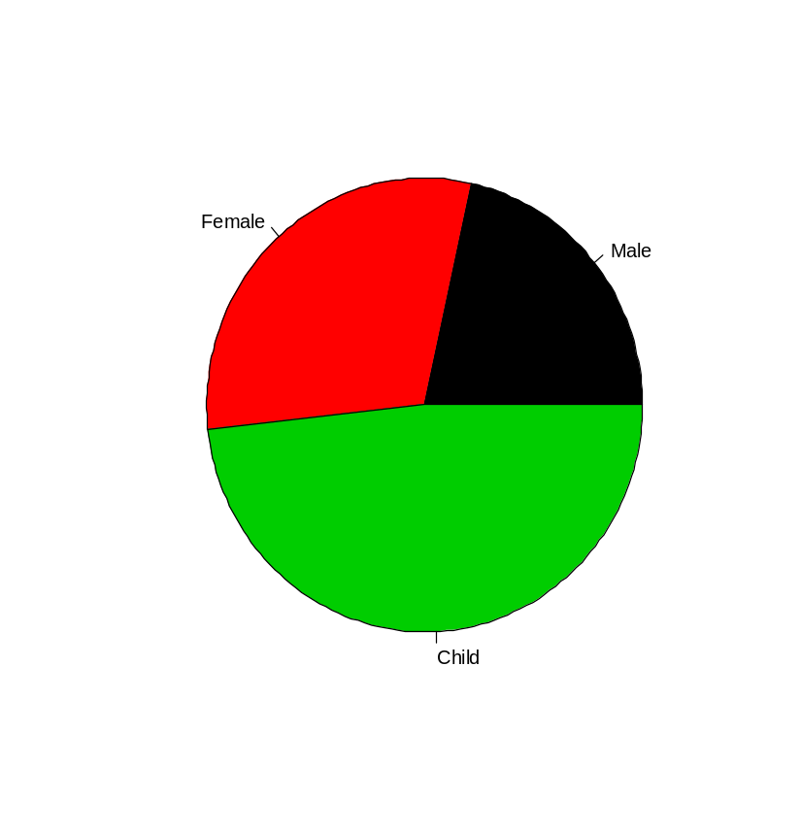
Pie chart
> group=c("Male", "Female", "Child")
> freq=c(25, 35, 56)
> names(freq)=c("Male","Female", "Child")
> pie(freq)
> pie(freq, col=c(1,2,3))

Slide 14
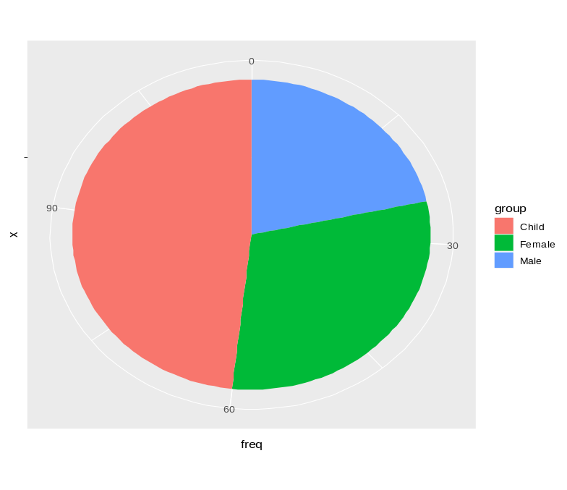
Pie Chart-ggplot
library(ggplot2)
group=c("Male", "Female", "Child")
freq=c(25, 35, 56)
df=data.frame(group,freq)
df
ggplot(df, aes(x="", y=freq, fill=group))+ geom_bar(width = 1, stat = "identity")+coord_polar("y", start=0)

Slide 15
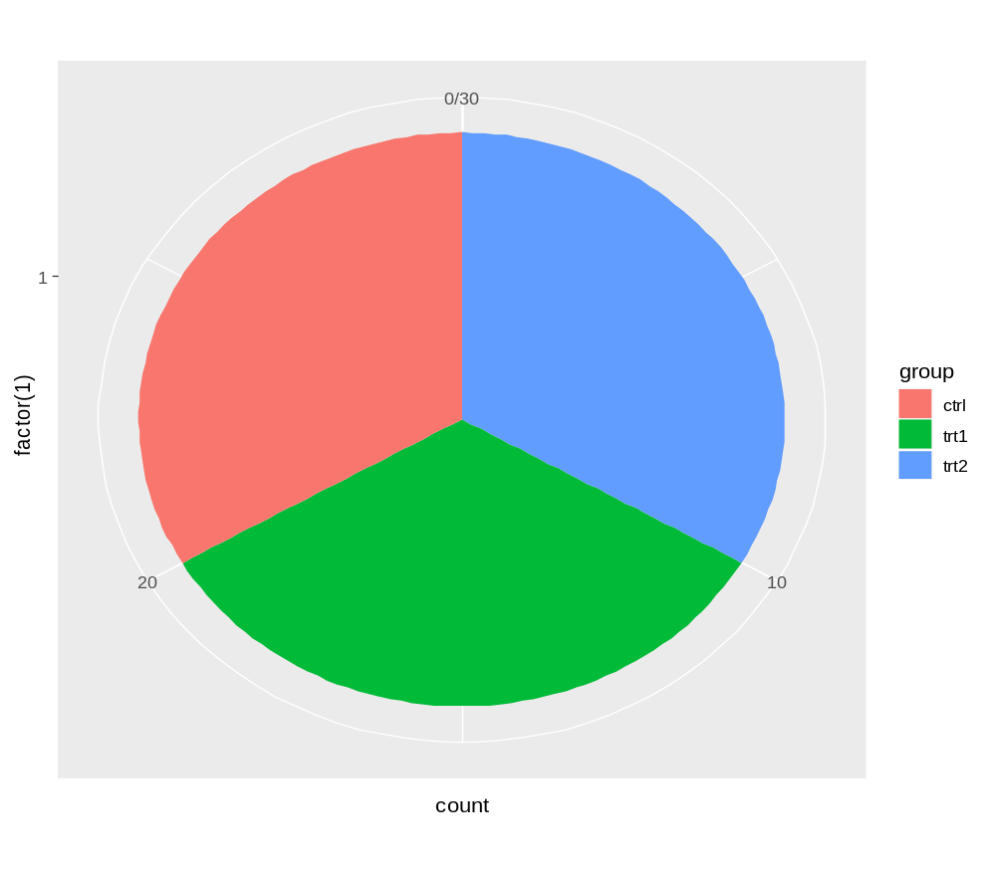
Pie chart from a factor variable
Consider a data set PlantGrowth in R
library(ggplot2)
ggplot(PlantGrowth, aes(x=factor(1), fill=group))+
geom_bar(width = 1)+ coord_polar("y")

Slide 16
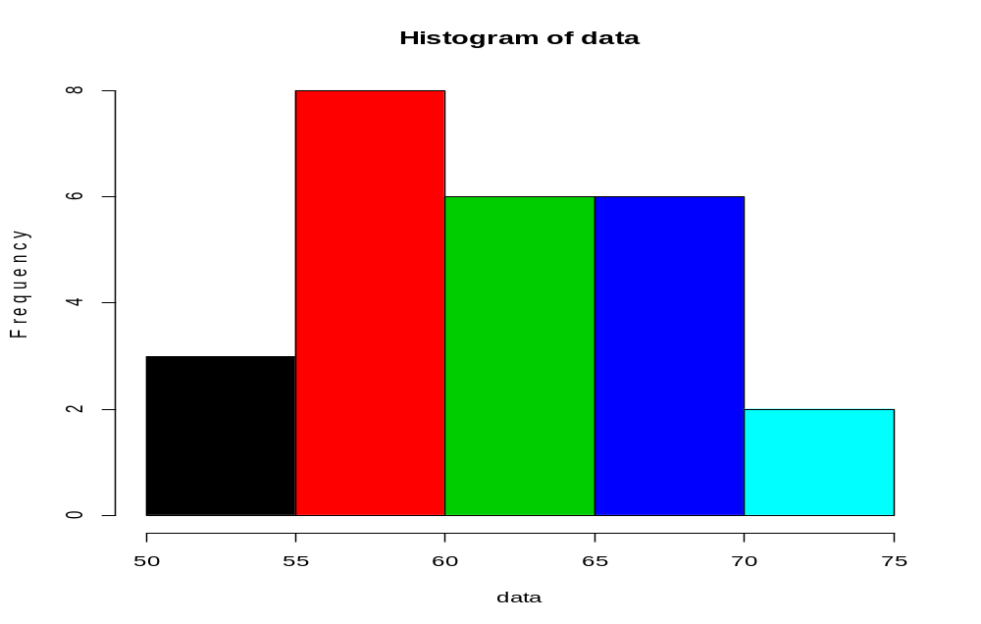
Histogram
data=c(70,60,66,54,66,60,55,57,67,71,62,69,57,63,69,
58,60,52,63,63,61,65,60,60,73)
hist(data, col=c(1,2,3,4,5))

Slide 17
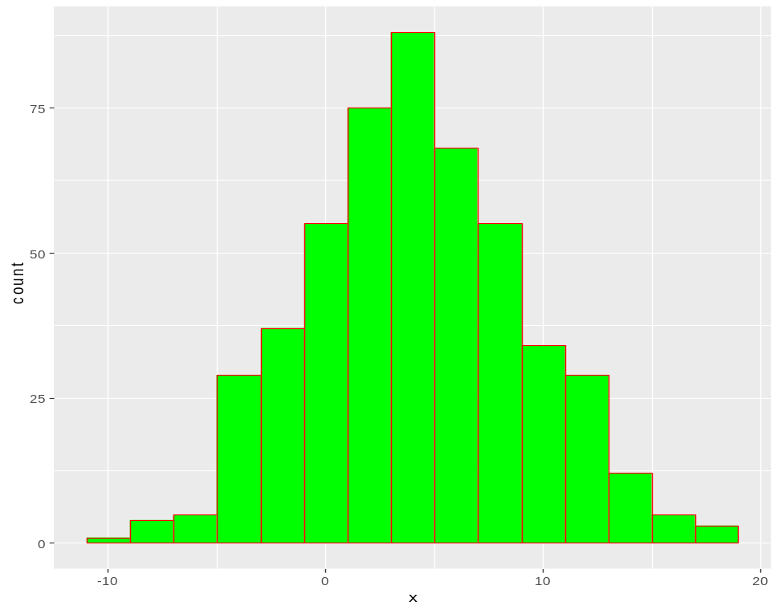
Histogram-ggplot
library(ggplot2)
x=rnorm(500,4,5)
df=data.frame(x)
ggplot(df, aes(x)) + geom_histogram(binwidth=2)
ggplot(df, aes(x)) + geom_histogram(binwidth=2,colour="red", fill="green")

Slide 18
Example
Consider the Boston housing data studied by Harrison and Rubinfeld “Hedonic prices
and the demand for clean air”, Journal of Environmental Economics & Management, vol. 5, p. 81–102, 1978.
boston=read.csv("C:\\Aryal\\Data\\BostonHousing.csv")
head(boston)
attach(boston)
hist(MEDV, xlab = "MEDV")
Using ggplot
library(ggplot2)
ggplot(boston) + geom_histogram(aes(x = MEDV), binwidth = 5)
Box-plot
boxplot(MEDV ~ CHAS, xlab = "CHAS", ylab = "MEDV")
# alternative plot with ggplot
ggplot(boston)+geom_boxplot(aes(x=as.factor(CHAS),y=MEDV))+ xlab("CHAS")

Slide 19
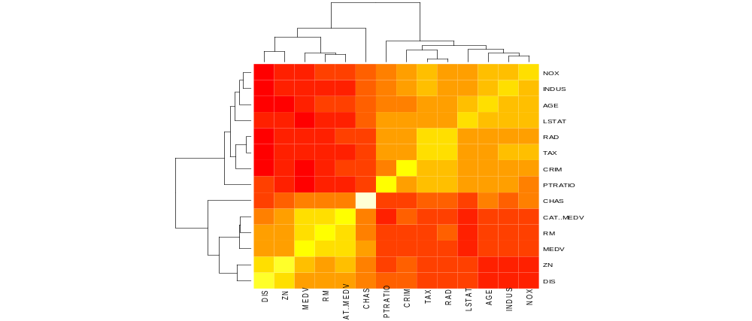
Heatmaps: Visualizing correlations
A heatmap is a graphical display of numerical data where color is used to denote values. In a data mining context, heatmaps are especially useful for two purposes: for visualizing correlation tables and for visualizing missing values in the data.
> heatmap(cor(boston), Rowv = NA, Colv = NA)
> library(ggplot2)
> library(reshape)
> cor.mat <- round(cor(boston),2)
> melted.cor.mat <- melt(cor.mat)
ggplot(melted.cor.mat, aes(x = X1, y = X2, fill = value))+ +geom_tile() +geom_text(aes(x = X1, y = X2, label = value))

Slide 20
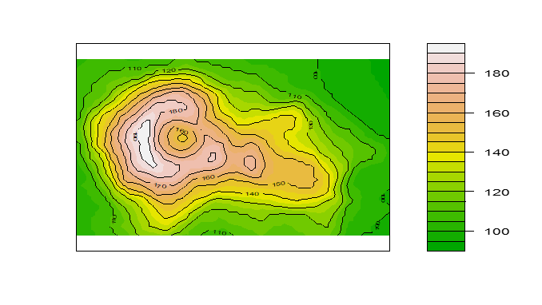
Contour plots
Contour plots can be plotted with contour() and filled.contour() in package graphics, and with contourplot() in package lattice.
> library(lattice)
> library(graphics)
> data(volcano)
> filled.contour(volcano, color=terrain.colors, +asp=1,plot.axes=contour(volcano, add=T))

Slide 21
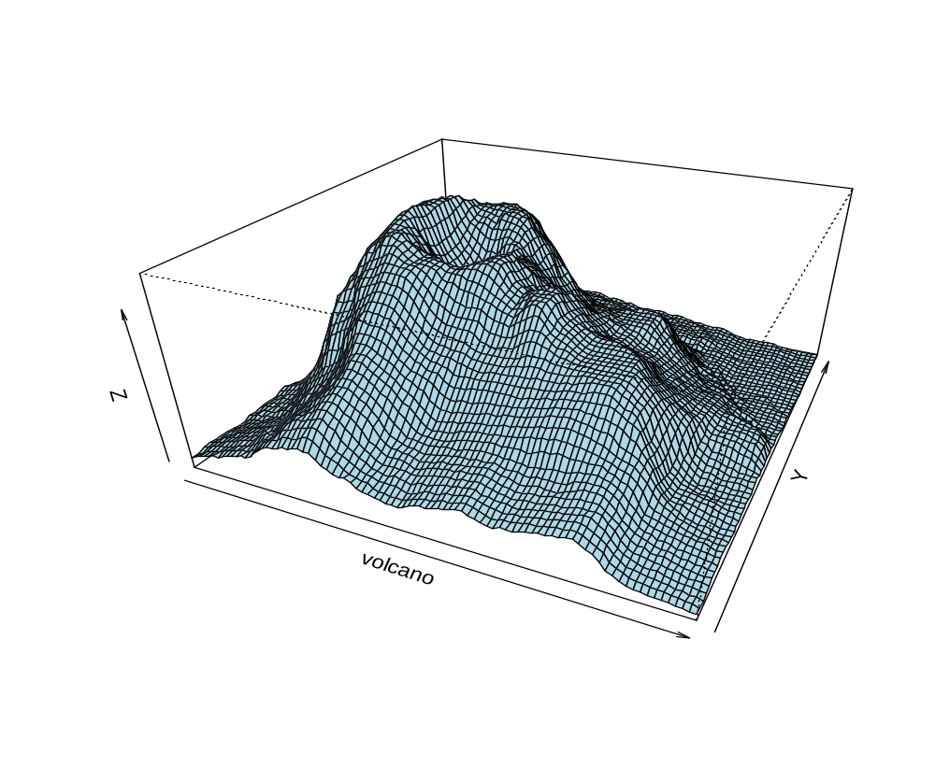
3D surface plot -persp
> data(volcano)
> persp(volcano, theta=25, phi=30, expand=0.5, col="lightblue")

Slide 22
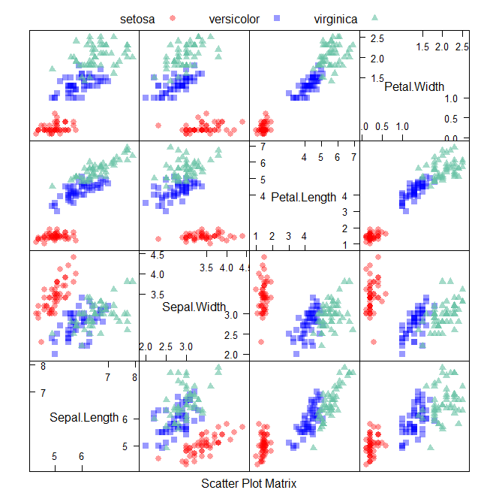
Feature plot
The caret package (short for Classification And REgression Training) is a set of functions that attempt to streamline the process for creating predictive models. The featurePlot function is a wrapper for different lattice plots to visualize the data.
> library(caret)
> data(iris)
> str(iris)
> library("AppliedPredictiveModeling")
> transparentTheme(trans = .4)
> featurePlot(x = iris[, 1:4], y = iris$Species, plot = "pairs", auto.key = list(columns = 3))

Slide 23
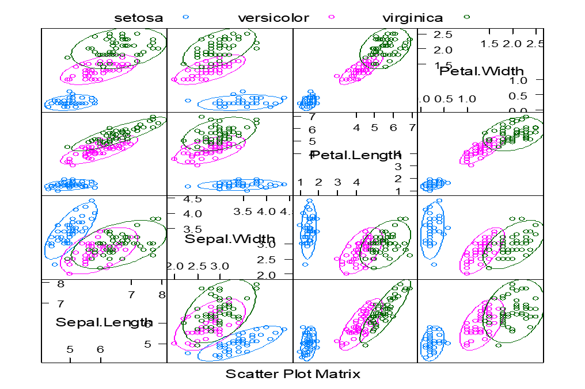
Scatterplot Matrix with Ellipses
>featurePlot(x = iris[, 1:4], y = iris$Species, plot = "ellipse", auto.key = list(columns = 3))
>featurePlot(x = iris[, 1:4], y = iris$Species, plot = "box")

Slide 24
Exploratory Data Analysis
EDA function in Basic Statistics and Data Analysis (BSDA) packages is helpful to perform
EDA.
> library(BSDA)
> data(Aids)
> attach(Aids)
> EDA(duration) # This will produce graphical display and numerical summary

Slide 25
Correlogram
# Example mtcars data
head(mtcars)
data=mtcars[,c(1,2,3,4,5,6,7)]
cor(data)
# Graphical display of correlation matrix
library(corrplot)
corrplot(cor(data))
corrplot(cor(data), method="number")
corrplot(cor(data), method="number", type="upper")
corrplot(cor(data), method="ellipse")

Slide 26
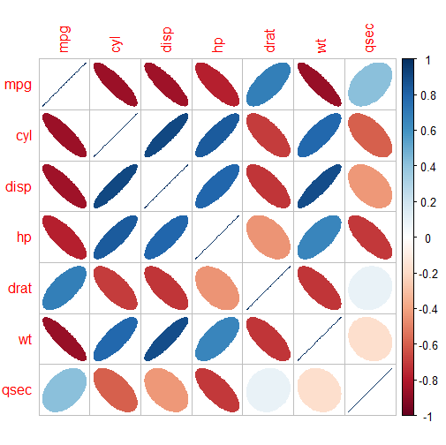
Correlogram
> corrplot(cor(data), method="ellipse")

Slide 27
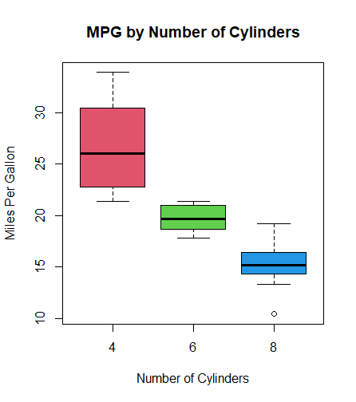
Box plots and Violin plots
> boxplot(mpg ~ cyl, data = mtcars, xlab = "Number of Cylinders", ylab = "Miles Per Gallon", main = "MPG by Number of Cylinders", col = c(2,3,4))

Slide 28
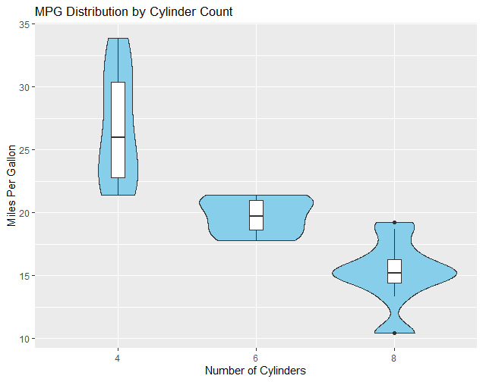
Box plots and Violin plots
> library(ggplot2)
> ggplot(mtcars, aes(factor(cyl), mpg)) + geom_violin(fill = "skyblue") + geom_boxplot(width = 0.1, fill = "white") +
labs(title = "MPG Distribution by Cylinder Count", x = "Number of Cylinders", y = "Miles Per Gallon")

Slide 29
More Interesting graphs
network visualization with ggplot2
https://briatte.github.io/ggnet/
Visualizing large data sets
http://geog.uoregon.edu/bartlein/courses/geog490/week08-visualizing.html

Slide 30
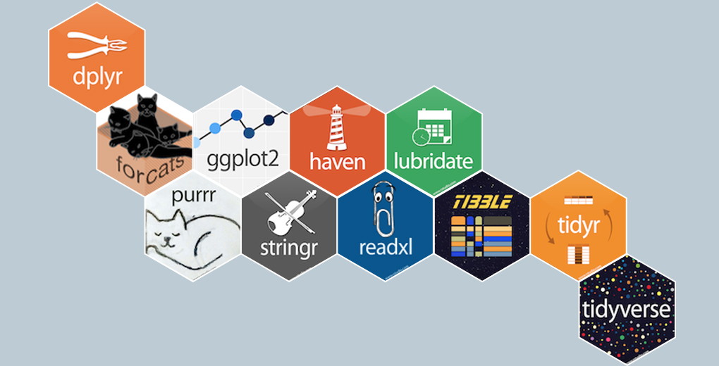
tidyverse package
tidyverse is a collection of essential R packages for data science. The packages under the tidyverse umbrella help us in performing and interacting with the data. There are a whole host of things you can do with your data, such as subsetting, transforming, visualizing, etc.
https://www.tidyverse.org/packages/

Slide 31
dplyr Grammar
Some of the key “verbs” provided by the dplyr package are
select: return a subset of the columns of a data frame, using a flexible notation
filter: extract a subset of rows from a data frame based on logical conditions
arrange: reorder rows of a data frame
rename: rename variables in a data frame
mutate: add new variables/columns or transform existing variables
summarise / summarize: generate summary statistics of different variables in the data frame, possibly within strata
%>%: the “pipe” operator is used to connect multiple verb actions together into a pipeline

Slide 32
Example- Chicago pollution and temperature data
> chicago=readRDS("C:\\Users\\aryal\chicago.rds")
> dim(chicago)
[1] 6940 8
> str(chicago)
The select() function can be used to select columns of a data frame that you want to focus on.
> attach(chicago)
> subset <- select(chicago, city:dptp)
> head(subset)
city tmpd dptp
1 chic 31.5 31.500
2 chic 33.0 29.875
3 chic 33.0 27.375
4 chic 29.0 28.625
5 chic 32.0 28.875
6 chic 40.0 35.125
> select(chicago, -(city:dptp))

Slide 33
Select() function
> i <- match("city", names(chicago))
> j <- match("dptp", names(chicago))
> head(chicago[, -(i:j)])
The select() function also allows a special syntax that allows you to specify variable names based on patterns. So, for example, if you wanted to keep every variable that ends with a “2” or starts with “d”
> subset <- select(chicago, ends_with("2"))
> subset <- select(chicago, starts_with("d"))

Slide 34
filter() function
The filter() function is used to extract subsets of rows from a data frame. This function is similar to the existing subset() function in R
For example to find observations for which pm25tmean2 is greater than 30 we use R code below
>chic.f <- filter(chicago, pm25tmean2 > 30)
We can place an arbitrarily complex logical sequence inside of filter(), so we could for example extract the rows where PM2.5 is greater than 30 and temperature is greater than 80 degrees Fahrenheit.
> chic.f <- filter(chicago, pm25tmean2 > 30 & tmpd > 80)

Slide 35
Arrange() function
The arrange() function is used to reorder rows of a data frame according to one of the variables
>chicago <- arrange(chicago, date)
For the descending order we can use R code below
>chicago <- arrange(chicago, desc(date))

Slide 36
rename() function
The rename() function is designed to rename the variables in a dataset.
> chicago <- rename(chicago, dewpoint = dptp, pm25 = pm25tmean2)
The syntax inside the rename() function is to have the new name on the left-hand side of the = sign and the old name on the right-hand side.

Slide 37
mutate() function
The mutate() function exists to compute transformations of variables in a data frame. Often, you want to create new variables that are derived from existing variables and mutate() provides a clean interface for doing that
> chicago <- mutate(chicago, pm25detrend = pm25 - mean(pm25, na.rm = TRUE))
There is also the related transmute() function, which does the same thing as mutate() but then drops all non-transformed variables.

Slide 38
group_by() function
The group_by() function is used to generate summary statistics from the data frame within strata defined by a variable.
For example, in this air pollution dataset, you might want to know what the average annual level of PM2.5 is. So the stratum is the year, and that is something we can derive from the date variable. In conjunction with the group_by() function we often use the summarize() function (or summarise() ).
First, we can create a year varible using as.POSIXlt().
> chicago <- mutate(chicago, year = as.POSIXlt(date)$year + 1900)
Now we can create a separate data frame that splits the original data frame by year.
years <- group_by(chicago, year)
Finally, we compute summary statistics for each year in the data frame with the summarize()
function.
> summarize(years, pm25 = mean(pm25, na.rm = TRUE),
+ o3 = max(o3tmean2, na.rm = TRUE),
+ no2 = median(no2tmean2, na.rm = TRUE))

Slide 39
Pipeline %>% operator
The pipeline operater %>% is very handy for stringing together multiple dplyr functions in a sequence of operations. The %>% operator allows you to string operations in a left-to-right fashion, i.e.
> first(x) %>% second %>% third
Example
Take the example that we just did in the last section where we computed the mean of o3 and no2 within quintiles of pm25. There we had to
1. create a new variable pm25.quint
2. split the data frame by that new variable
3. compute the mean of o3 and no2 in the sub-groups defined by pm25.quint
That can be done with the following sequence in a single R expression.
> qq <- quantile(chicago$pm25, seq(0, 1, 0.2), na.rm = TRUE)
> quint <- group_by(chicago, pm25.quint)
> mutate(chicago, pm25.quint = cut(pm25, qq)) %>%
+ group_by(pm25.quint) %>%
+ summarize(o3 = mean(o3tmean2, na.rm = TRUE),
+ no2 = mean(no2tmean2, na.rm = TRUE))

Slide 40
Pipeline %>% operator
> x <- c(-1, 0, NA, 22, NA)
> x %>% mean(na.rm=TRUE)
[1] 7
Example
>data <- c(30.75, 0.97, 12.46, 40.79, 28)
> data%>%
>diff(lag=2) %>%
> round(digits=1)

Slide 41
Pipeline %>% operator example
> library(dplyr)
> mtcars %>%
+ filter(carb > 1) %>%
+ group_by(cyl) %>%
+ summarize(Avg_mpg = mean(mpg)) %>%
+ arrange(desc(Avg_mpg))
    # A tibble: 3 x 2
    cyl Avg_mpg
    <dbl> <dbl>
    1 4 25.9
    2 6 19.7
    3 8 15.1

Slide 42
References
tidyverse Package
https://www.tidyverse.org/packages/
R programming for Data Science- Roger D. Peng

Slide 43
Thank you

